Slide 1
Gravitational Waves (GWs) dynamics
Beyond the Standard Model (BSM) of Particle Physics:
Prospects for the future space-borne experiments
Lucia A. Popa
L.A. Popa, Physics of the Dark Universe (2025) D24, 00862
arXiv: 6128737 [hep-ph]
Outline:
Motivation
BSM to Cosmology
GWs background from inflation
Constraints and back reactions
Prospects for the future space-born GW experiments
Conclusions

Slide 2
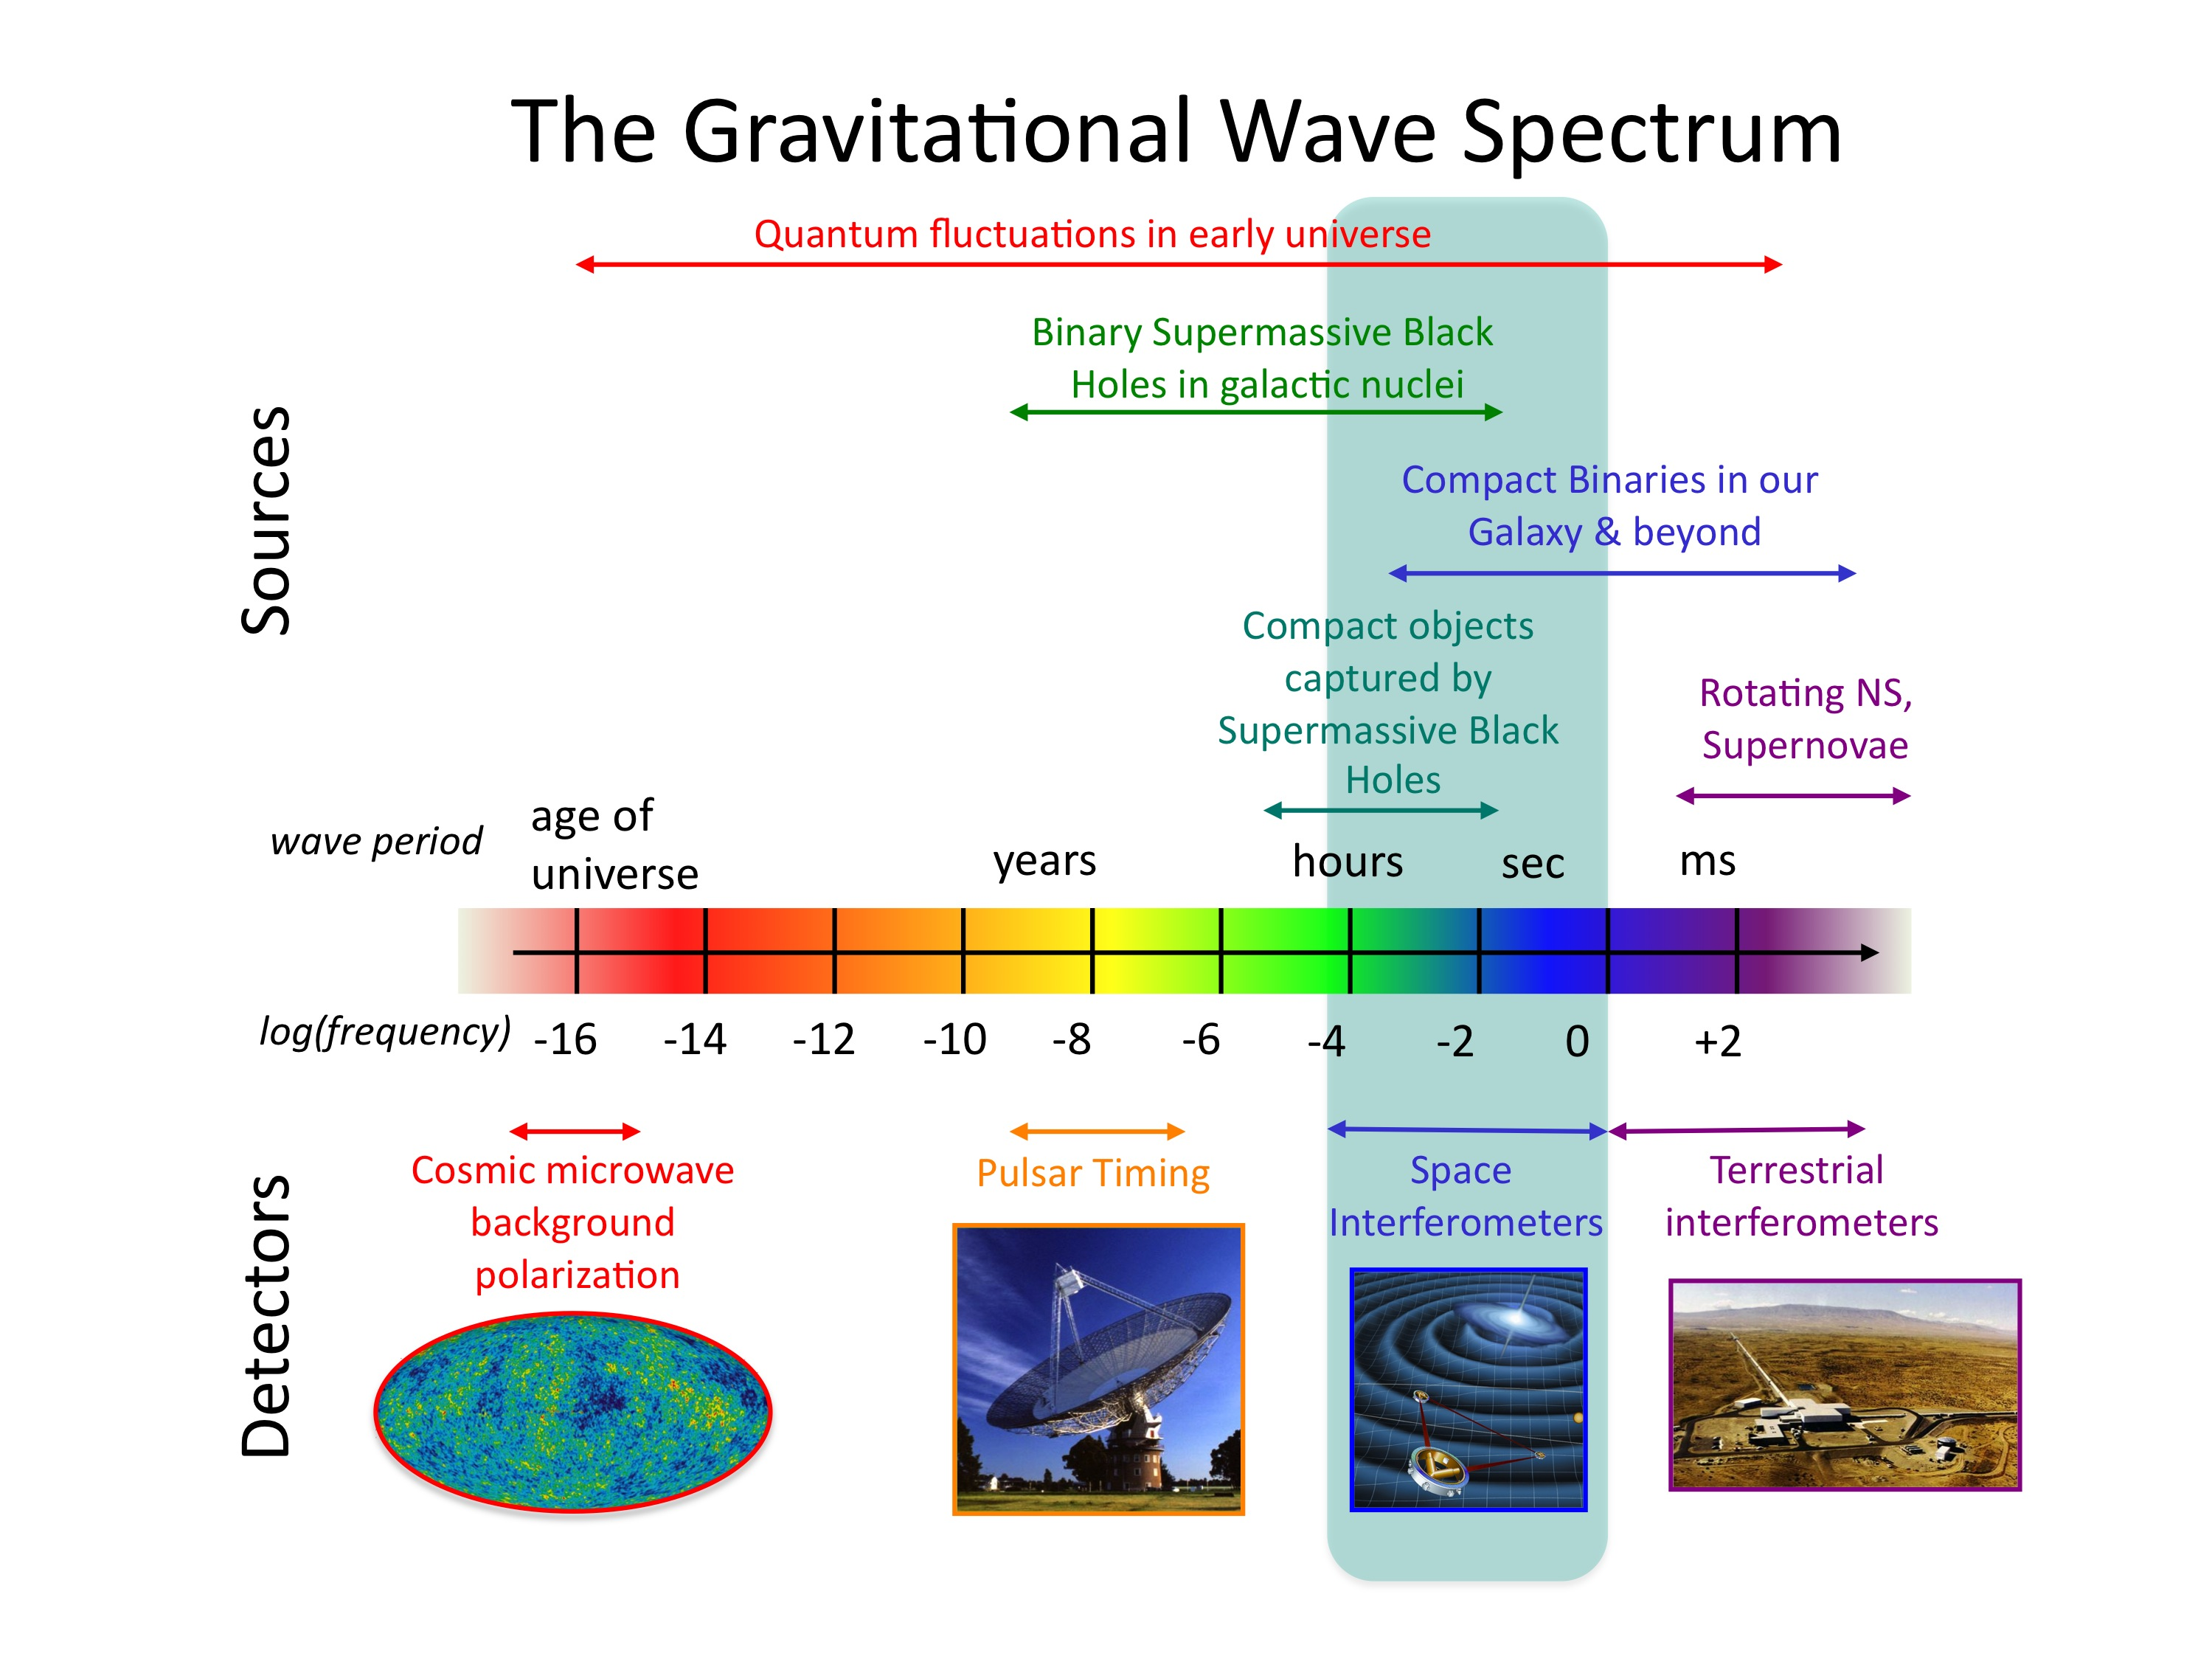
GWs transport gravitational RADIATION generated by the relative motion of gravitating masses.
Primordial GWs produced during inflation
N_{eff} =3.046 - SM
Δ N_{eff} - BSM
-neutrino species, hierarchy
-baryon/lepton asymmetry
-recombination, nucleosynthesis
LiteBIRD
Lite (Light) satellite for the study of B-mode polarization and Inflation from cosmic background Radiation Detection
Popa, L.A., Tonoiu, D., JCAP 9, 066 (2015).
Caramete, A., Popa, L.A., JCAP, 2, 012 (2014).
Popa, L. A., Caramete, A., ApJ 723, 1 803 (2010).
LISA – Laser Interferometer Space Antenna
DECIGO - Deci-Hertz Interferometer GW Observatory
BBO - Big-Bang Observer (BBO)

Slide 3
Standard Model of Cosmology
ΛCDM: six free parameters + Inflation + GR
All needded to describe
the present Universe
16th MoEDAL Collaboration Meeting December 15-17 2021

Slide 4
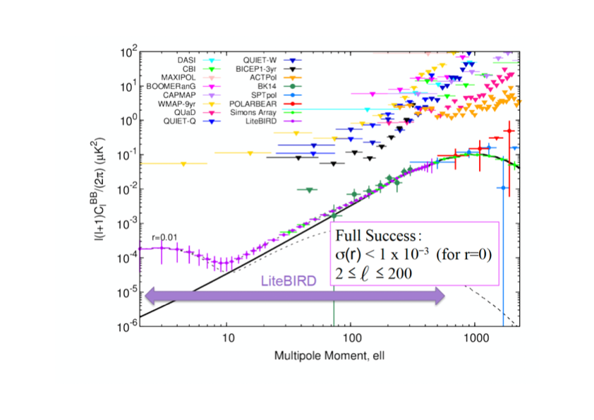
LiteBIRD expectations:
Perform a measurement at the limit of r < 0.001
Test the scale dependence, gaussianity, and chirality imprinted on CMB B-mode polarization.
Provide information on the underlying REALISTIC inflationary dynamics.

Slide 5
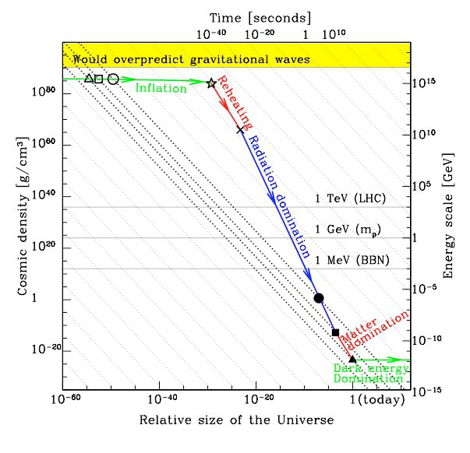
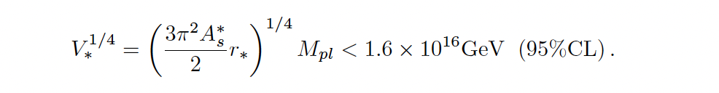
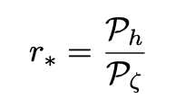
Issue: Energy scale separation between hidden and visible sectors
Planck scale
Origins of the primordial GW background ?
Quantum vacuum fluctuations: nearly scale invariant, nearly non-gaussian, parity conserving (non-chiral)
Matter fields: energetically-excited extra particle content present during inflation (New Physics)
SU(2) X SU(1) EWSB
GW background from inflation imprinted in B-mode polarization of the CMB represents one of the main targets of ongoing experimental efforts.

Slide 6
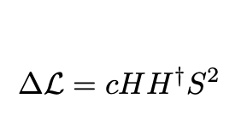
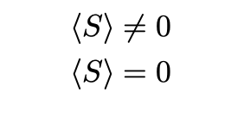
Higgs-portal to inflation
Higgs field is the single gauge and Lorentz invariant
dimension–2 operator in SM
Higgs – portal:
couple visible and “hidden” sectors at the renormalizable level
inflaton
DM particle
Can be proved at the LHC by measuring production cross sections for the Higgs–like states

Slide 7
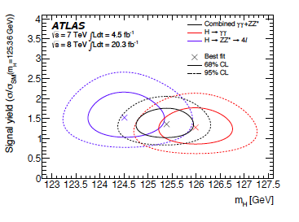
Planck: 124 GeV < M_{H} < 127 GeV at 95% CL
M_{Top}= 172 GeV
Popa, L.A., JCAP, 025 (2011).
Popa, L. A., Caramete, A., ApJ 723, (2010).
Popa, L. A., Mandolesi, N., Caramete, A., Burigana, C., APJ 706 (2009).

Slide 8
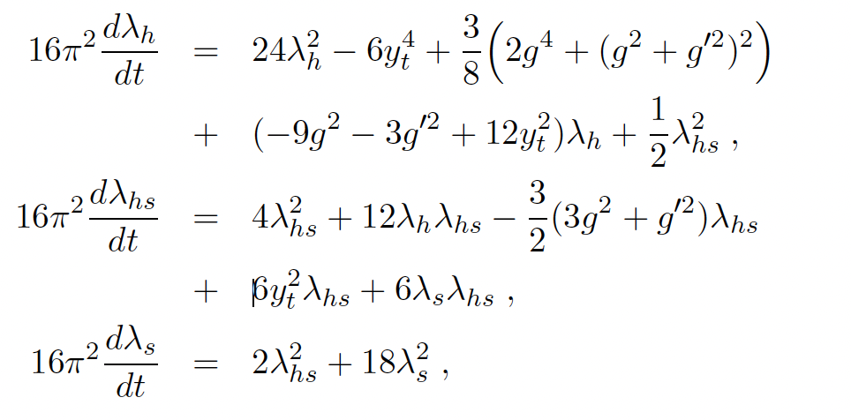
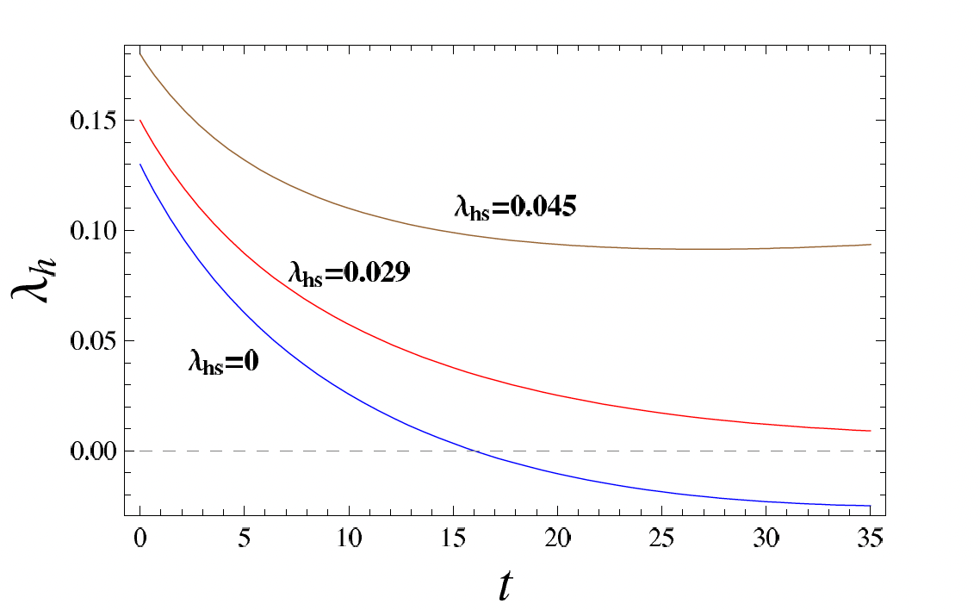
Renormalization Group of the SM couplings:
Stabilization of EW vacuum

Slide 9
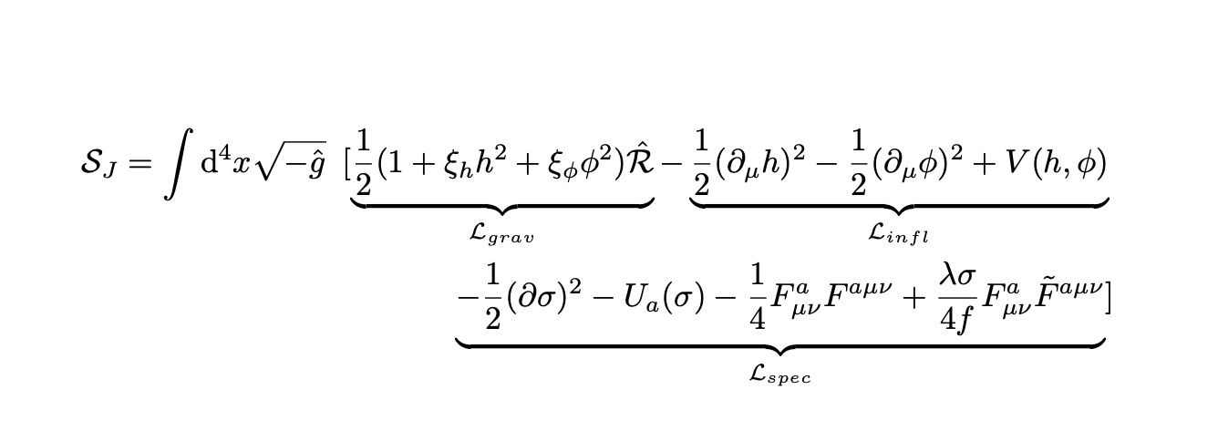
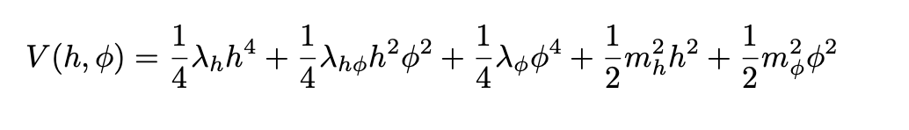
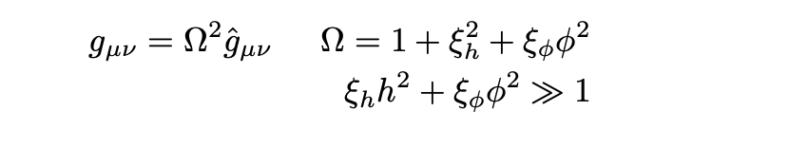
Vacuum fluctuations from Higgs-singlet inflation
Jordan frame action:
Z₂ - symmetric BSM inflation potential:
Conformal transformation:

Slide 10
Higgs-singlet inflation: quantum vacuum fluctuations
B-mode APS

Slide 11
VeV:
Mass eigenstates:
Higgs-singlet mixing angle:

Slide 12
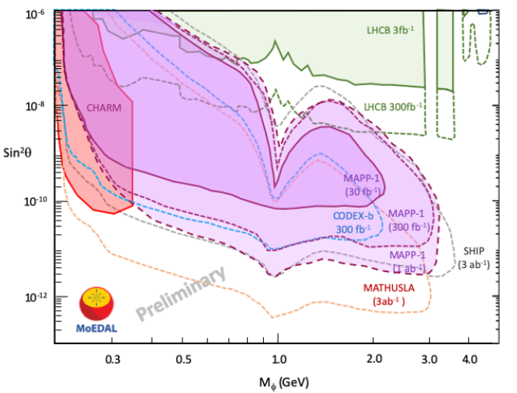
MoEDAL/MAPP-1 & FASER-2 reach
for Higgs-singlet inflaton
L.A. Popa, Universe (2022) 9, 235
L.A. Popa, Universe (2021) 7, 309

Slide 13
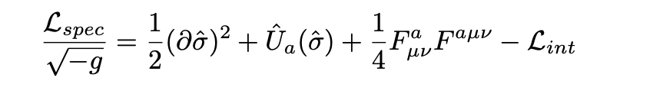

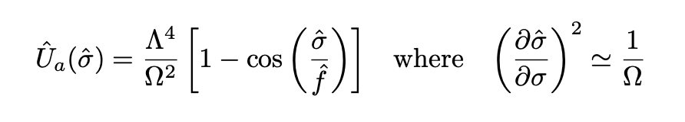
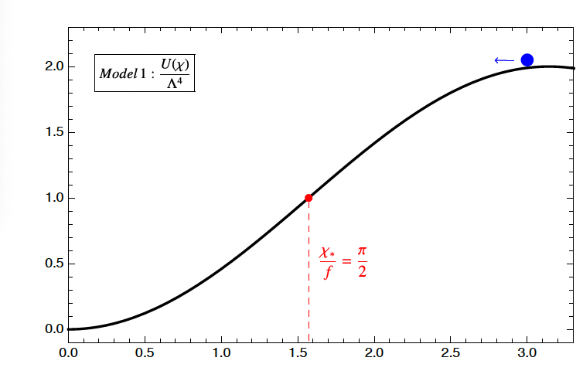

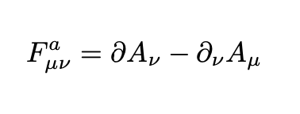
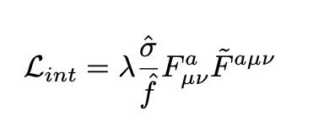
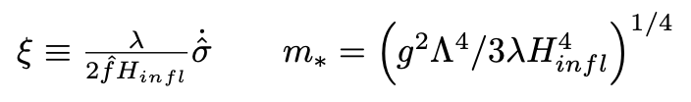

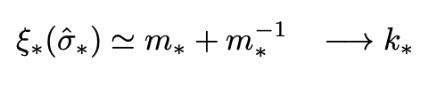
Transiently rolling spectator :
U(1) axion field :
SU(2) gauge field :
Chern-Simons term:
scale that exits horizon when axion velocity
and SU(2) gauge field mass are maximal

Slide 14
Scale dependence
Enhanced B-mode polarization power spectrum
Enhanced tensor power amplitude
recombination
reionization

Slide 15
Issue: Gauge field evolution with backreactions

Slide 16
Primordial GWs energy spectrum for LiteBIRD observing strategy
K. Schmitz, New Sensitivity Curves for Gravitational-Wave Experiments (2020) https://zendo.org/records/368958

Slide 17

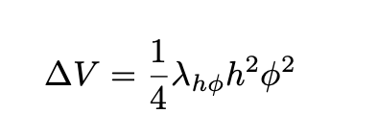

Conclusions
Goal: perform a measurement at the limit of r < 0.001 and testing the scale dependence, gaussianity, and chirality imprinted on CMB B-mode polarization
Higgs portal assisted inflation
Perturbativity constraints:
Vacuum stability constraints:
Background and perturbation evolution for other BSM fields:
B-mode satellite mission with access to large and intermediate CMB scales (e.g. LiteBIRD) and LHC experiments (e.g. ATLAS and CMS) would help in distinguishing source of GW primordial GW.

Slide 18
Science requirements making mechanism
LiteBIRD experimental configuration
LiteBIRD experimental sensitivity
LiteBIRD Col. White Paper, Prog. Theor. Exp. Phys. (2023).

